Slide 1

Requirements Documents
Electronic Engineering, Hochschule Hamm – Lippstadt 2021
Gordan Konevski
Electronic Engineering 2021

Slide 2
Motivation
Delineate the uses and categorizations of requirements documents
Describing the different categories
Conceptualizing those differences
Conceptualizing potential issues and definitive flaws
Electronic Engineering 2021

Slide 3
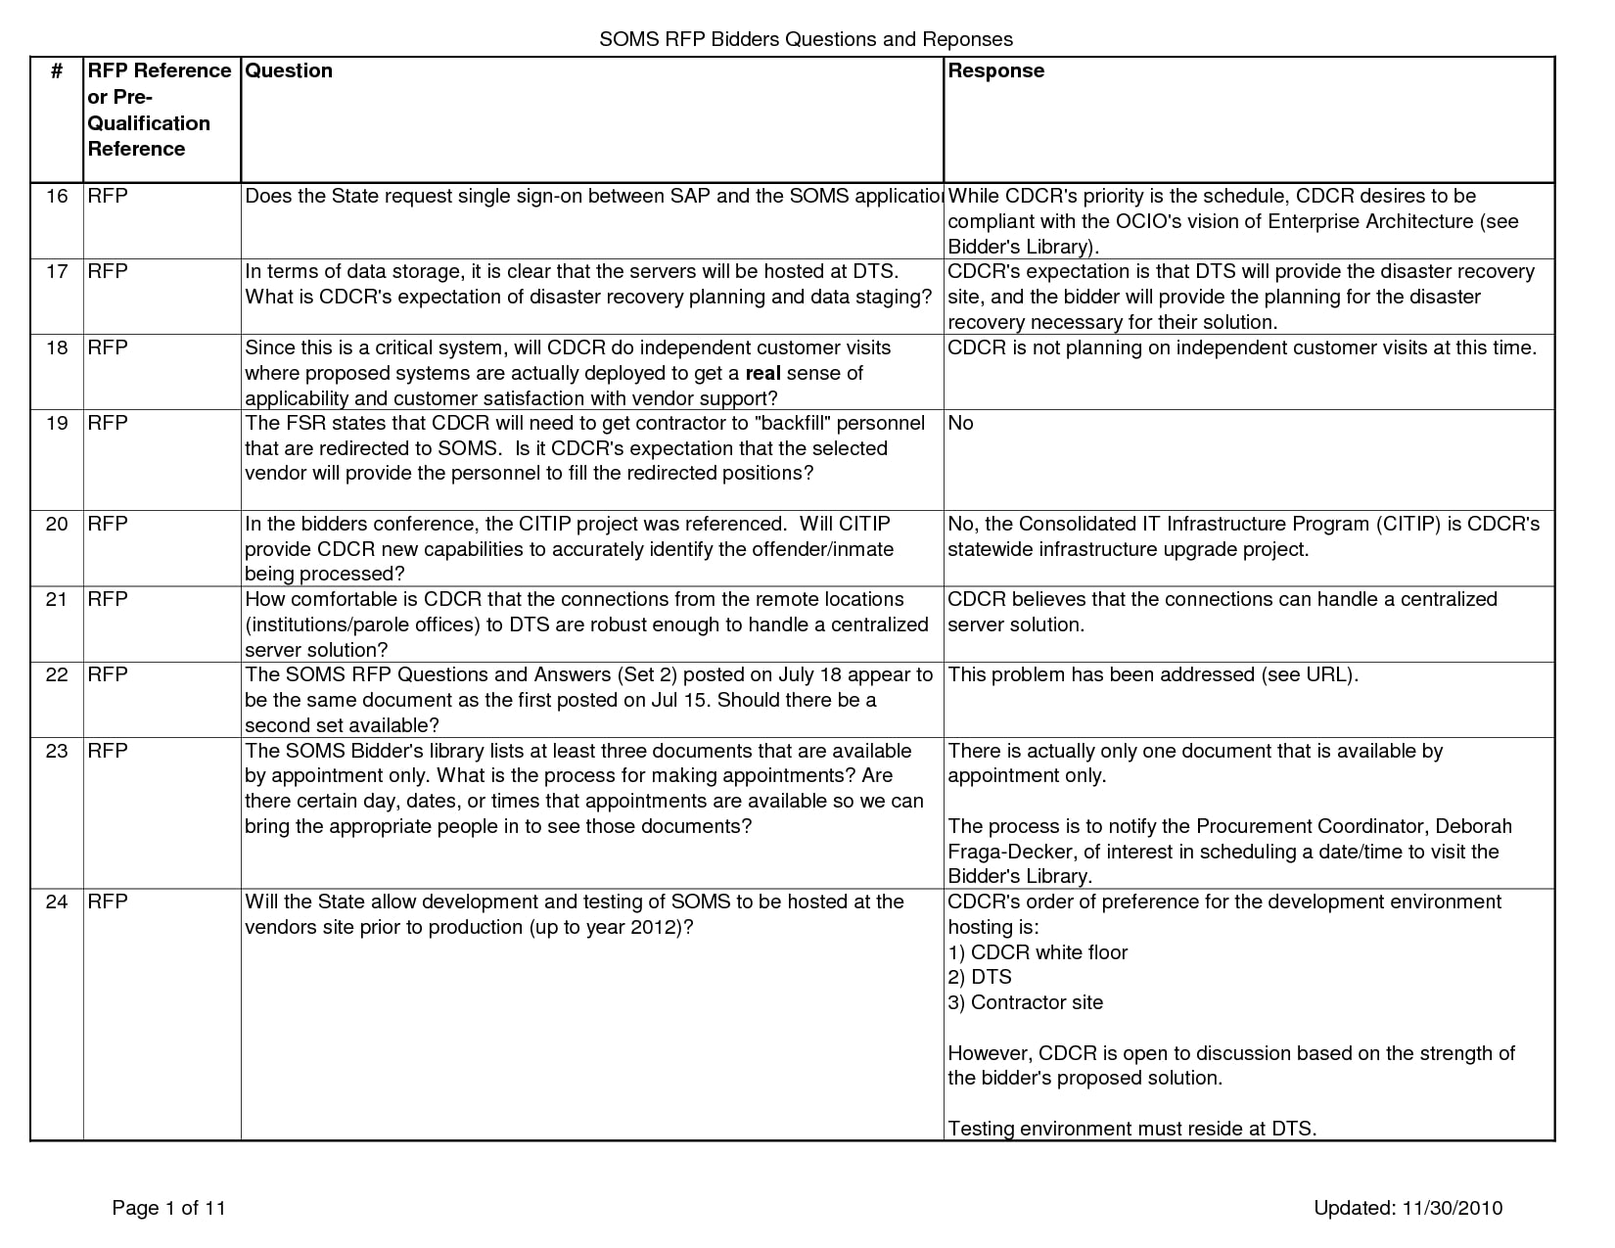
Example of a Requirements Document Handout
Electronic Engineering 2021

Slide 4
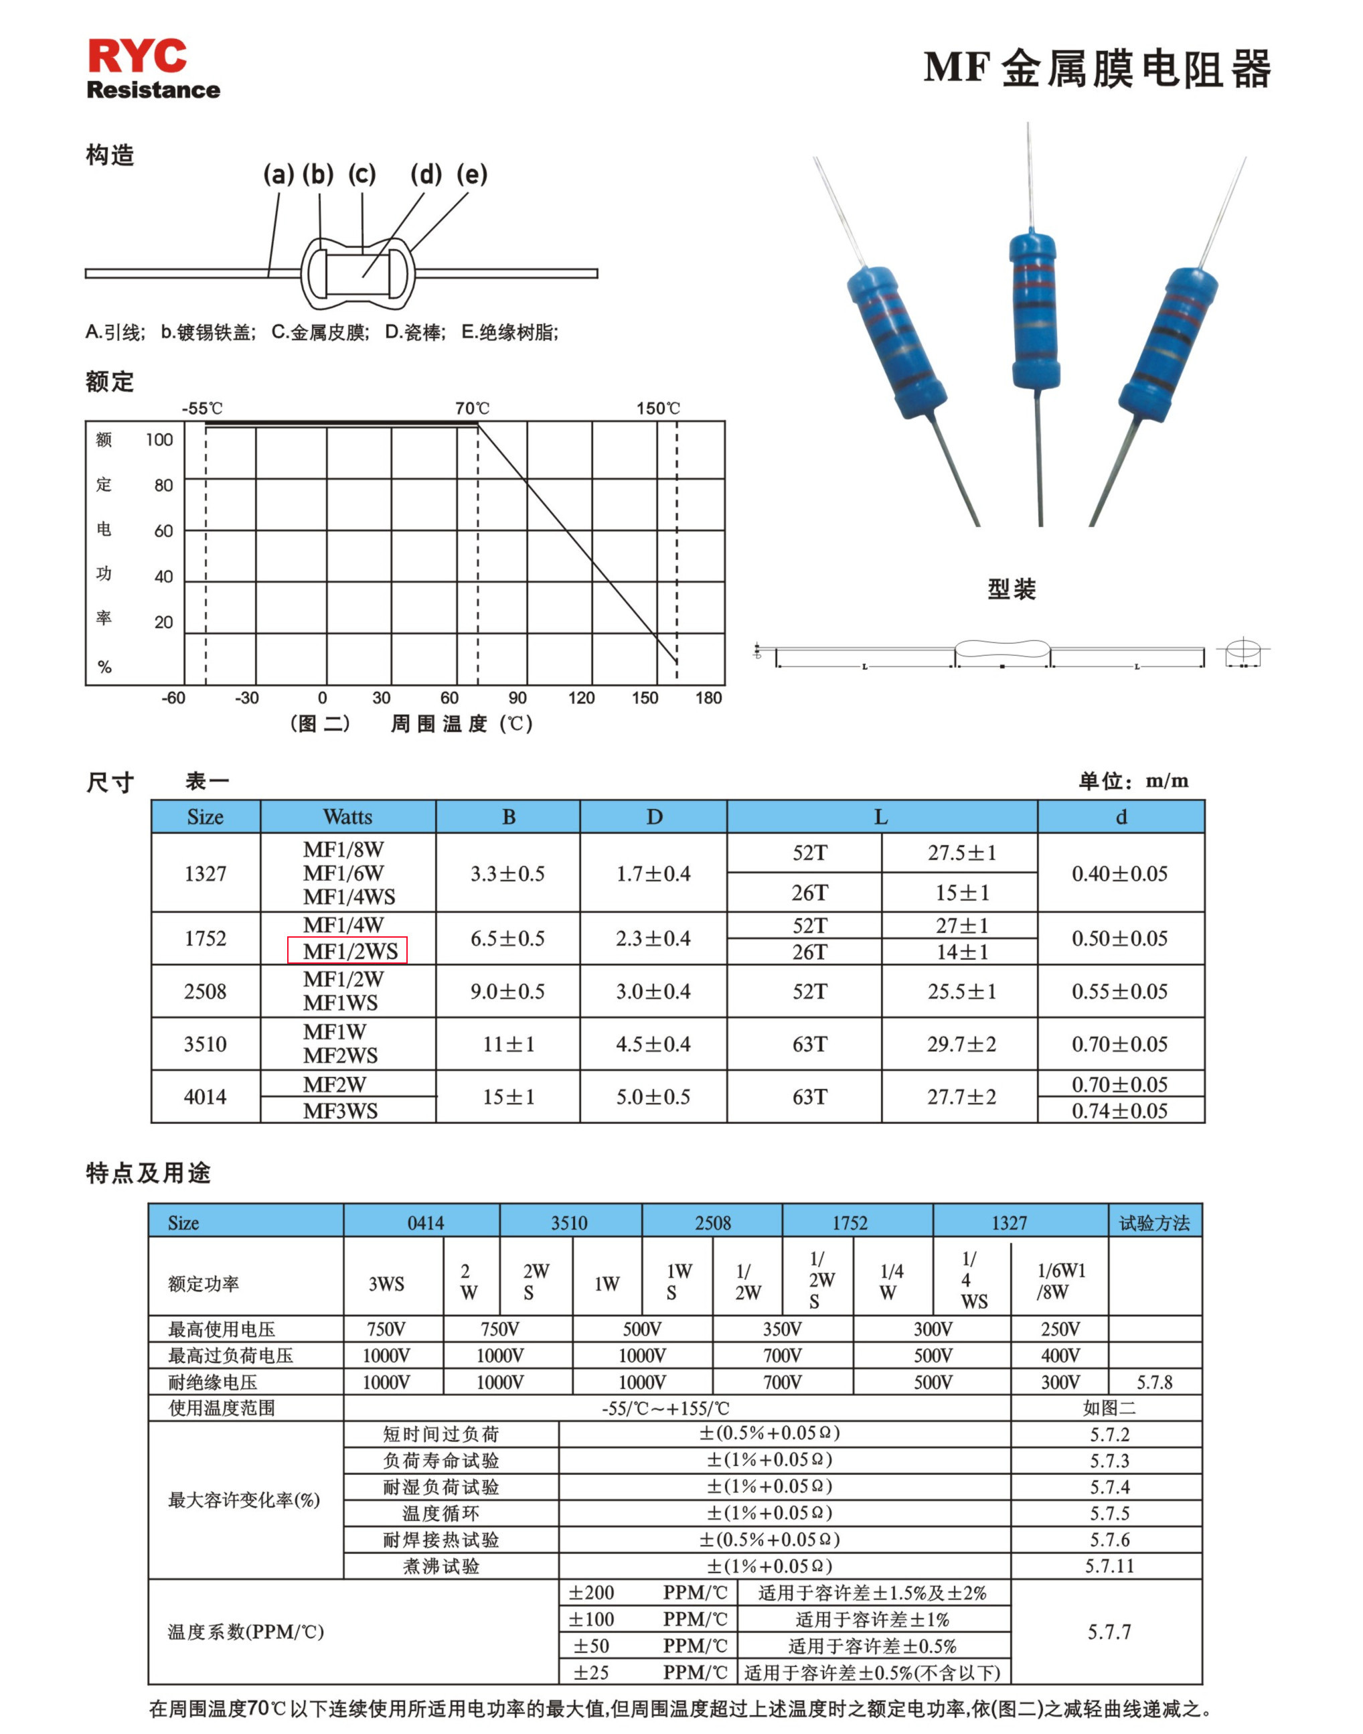
Spec Sheets
A product data sheet (PDS), like any data sheet, has a different data model per category. It typically contains:
Identifiers like manufacturer & manufacturer product code
Classification data
Descriptions such as marketing texts
Specifications
Product images
Feature logos
Reasons-to-buy
Leaflets, typically as PDFs
Manuals, typically in PDF.
Product videos, 3D objects, and other rich media assets
This Photo is licensed under CC BY-SA
Electronic Engineering 2021

Slide 5
The Nine Categories
Business Requirements Document (BRD)
Functional Requirements Document (FRD)
Market Requirements Document (MRD)
Product Requirements Document (PRD)
User Interface Requirements Document (UIRD)
Technical Requirements Document (TRD)
Quality Requirements Document (QRD)
Software Requirements Specification (SRS)
  Sentiment of a Software Requirements Specification Document
Customer Requirements Document (CRD; or basically PRD+)
Electronic Engineering 2021

Slide 6
Remarks on issues and flaws; Conclusion;
The main point behind that can be taken out of this research paper is that the requirements documents has some definitive flaws. Most of these flaws stem from its overreaching nature. Requirements documents, regardless of their category, tend to easily become too large and heavy. It is usually necessary to provide simple handouts on top of the requirements documents in order to make them more accessible. This makes the entire process of executing on requirements documents quite slow and cumbersome, and often convoluted due to its interdisciplinary nature. Translating these documents into specific models, which are chosen in accordance to the project, would greatly increase their accessibility and would make communicating with different departments and sectors far easier. However, requirements are a must, that is to say: no project could ever be developed without them. Even if they are eventually translated into different systems models, they are a necessary prerequisite to any project taken seriously.
Electronic Engineering 2021

Slide 7
Thank You for Your attention!
Electronic Engineering 2021

